Slide 1

Rent Quest
Your Quest, Our Analysis
U.C.Berkeley Bootcamp Feb 2019
Prem Ganesh, Amitava Samaddar
& Suvrangshu Ghosh

Slide 2

Finding a perfect rental at Bay Area
Where to look ?
Which web has better and most listings??
Which location has more availability?

Slide 3

Our Quest
We scraped rental data from multiple major web sites
Craigslist.org
Sulekha.com

Slide 4

Web Scraping
Scraped multiple websites
Picked multiple available rental locations at Bay area
Processed more that 1000+ records

Slide 5

Data Selection & cleanup
Cleanup process
Multiple data scan
Removed special characters
Removed null value
Text to integer conversion
Description
Price
Selection Process
Location
Number of rooms

Slide 6
Final Data
The data is converted to structured csv files and then stored in MongoDB
Craigslist Sulekha
Title | Price | Location | Bed Room
Beautiful home walking distance from Downtown Campbell | $1000 | Cambell | 1
Magnificent 2bed near West Wind Capitol Drive-In | $1000 | San Jose | 1

Slide 7
Benefit
Availability Vs Locations
From the data, many helpful analysis can be derived.
Which web has most listings?
Which location has cheap rentals?
Availability By room number
Which location has high rent?

Slide 8

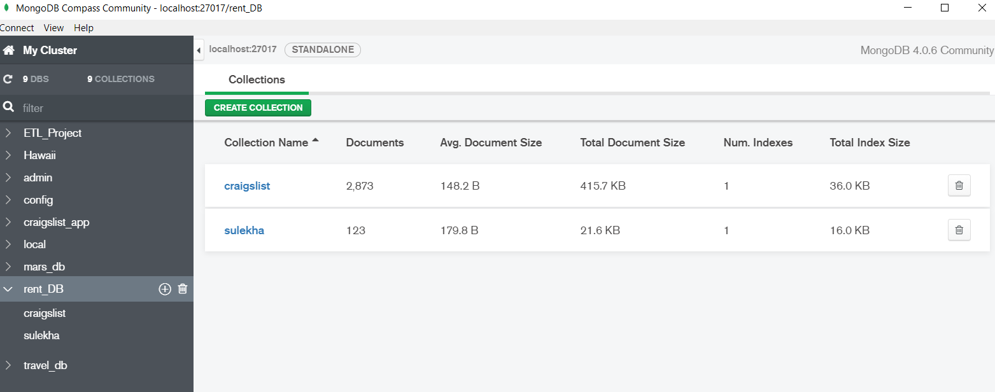
Database - mongodb
Showing collections Craigslist and Sulekha

Slide 9
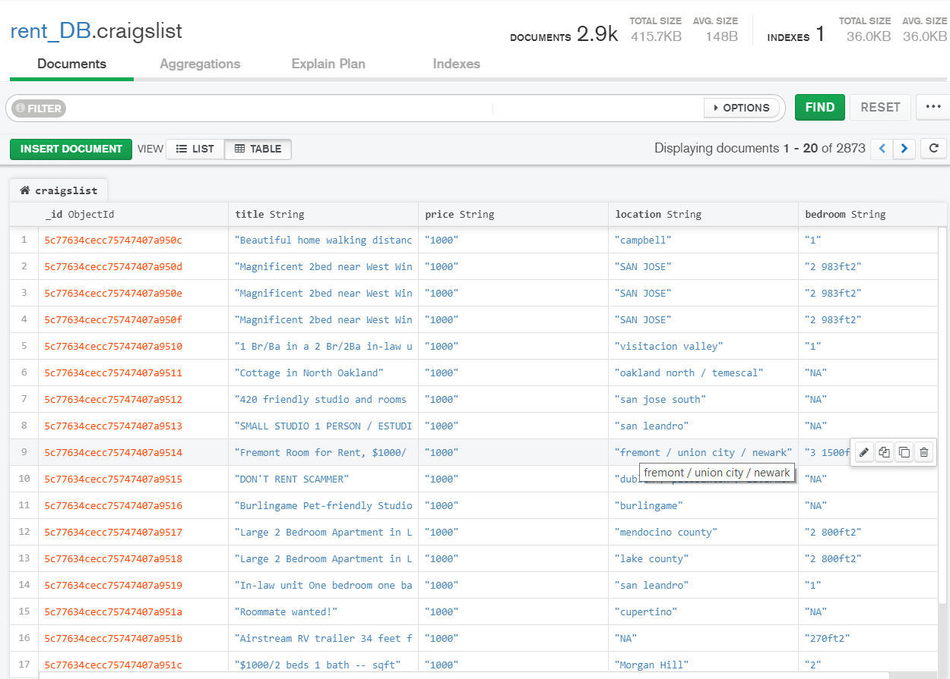
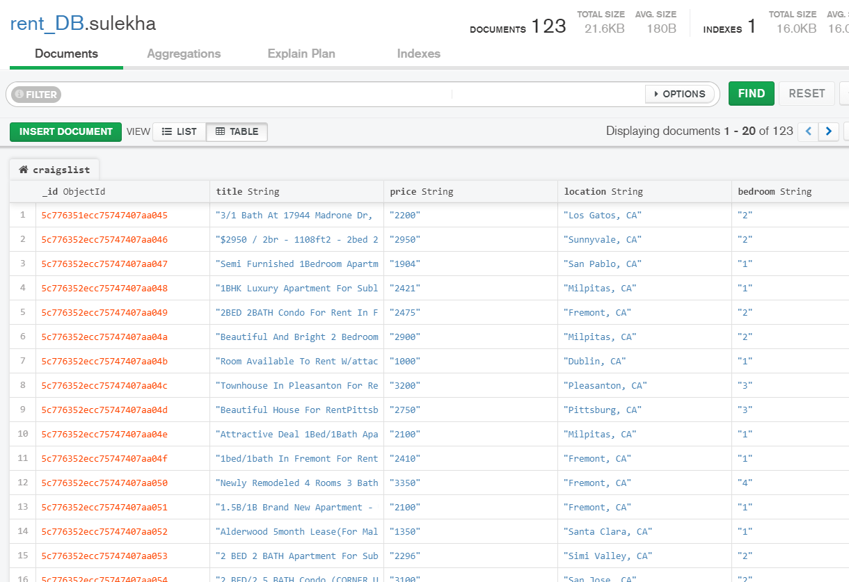
Database MongoDB Collections

Slide 10

THANK YOU!

